Slide 1
Lispz - Functional Functionality
http://lispz.net
https://github.com/CanFP/Talk-2016-06-15-Lispz-functional-functionality
https://docs.google.com/presentation/d/1iFG0HLO1ZI1sV3IYHQe_YtGU-NlIAfRsaaGeidd2MGc/edit?usp=sharing

Slide 2
Eager Expression Evaluation
(ref first ((new Date).getTime)) (delay 1532 (ref second ((new Date).getTime)) (console.log (- second first)) )

Slide 3
Lazy Expression Evaluation
(ref time! (once ((new Date).getTime))) (ref first (time!)) (delay 1532 (ref second (time!)) (console.log (- second first)) )

Slide 4
Lazy Expression Evaluator - Usage
(ref fs (lambda [name branch] (ref repo (once (repo> name))) (ref entries> (once (when (tree> (repo) fs.branch) [tree] (dict.from-list tree.tree "path") ))) (ref read> (lambda [path] (github.read> (repo) fs.branch path))) (ref fs { name entries> read> branch: (or branch "master")}) )) ##... (ref repo (github.fs “paulmarrington/lispz” “master”) ##... (ref lispz-js (repo.read> "lispz.js")) (ref groups (when repo.entries> (group @)))

Slide 5
Lazy Expression Evaluator - Implementation
(global #once (lambda [lazy-expression] (ref first-time (=> (ref evaluated-value (lazy-expression)) (action.update! { func: (=> evaluated-value) }) evaluated-value )) (ref action (lispz.globals.stateful { func: first-time when: (new Date) })) (=> (action.func)) )) (macro once [*body] (#once (=> *body)))

Slide 6
Recursion without Tail-Call Optimisation
(ref sum (lambda [x y] (cond (> y 0) (sum (+ x 1) (- y 1)) (else) x } }) (console.log (sum 1 100000)) ## => ERROR

Slide 7
Recursion with Tail-Call Optimisation
(ref sum (recursion [x y] (cond (> y 0) (sum (+ x 1) (- y 1)) (else) x } }) (console.log (sum 1 100000)) ## => ERROR

Slide 8
Tail-Call Optimisation - Implementation
(global #recursion (lambda [context func] (lambda (ref args (*arguments)) (cond context.queue (context.queue.push args) (else) (do (context.update! { queue: [[args]]}) (#join '' 'while(' (ref next-args (context.queue.shift)) '){' (context.update! { result: (func.apply null next-args)}) '}')) ) context.result ) )) (macro recursion [?params *body] (#recursion (stateful) (lambda ?params *body)) )

Slide 9
Currying - Implementation
(global curry (lambda [func] (ref curried (=> (ref args (*arguments 0)) (cond (>= args.length func.length) (func.apply func args) ## all done, run it (else) (=> ## otherwise return a partial function (curried.apply this (args.concat (*arguments 0))) ) ) )) )) (macro curry [params *body] (lispz.globals.curry (lambda params *body)))

Slide 10
Caching - Implementation
(global stateful.cache (curry [store update key] (or (get store key) (do (store.update! key (update key)) (get store key) )) )) ## ... (ref dom-events (stateful)) (ref post-dom-event> (lambda [address] (ref send-to-address (lambda [pkt] (message.send address pkt))) (stateful.cache dom-events (=> send-to-address) address) ))
## …
(element.addEventListener event-name (post-dom-event> address))

Slide 11
Caching
(ref exchange (stateful)) (ref observers (stateful.cache exchange (=> (stateful []))))
## ... (ref listen (lambda [address action>] ((observers address).push! (stateful { action> })) ))
## ... (ref request> (lambda [address packet] (ref postman (lambda [obs] (promised (obs.action> packet obs)))) (promise.all ((observers address).map postman)) ))

Slide 12
Reactive Messaging
(using [message dom] (message.clear '/my-message-address/') (message.trace '/my-message.*/') (ref @click (dom.click "my-message-address" document.body)) (ref @mouse (message.map @click "mouse" (lambda [event] {x: event.clientX y: event.clientY} ))) (ref @top-left (message.filter @mouse "top-left" (lambda [pos] (< pos.x pos.y) ))) (message.listen @top-left (=> (console.log @.x @.y))) )

Slide 13
Reactive Messaging using Compose
(using [message dom] (message.clear '/my-message-address/') (message.trace '/my-message.*/') ## Same again using compose (cascade (=> (dom.click "my-message-address" document.body)) (=> (message.map @ "mouse" (=> {x: @.clientX y: @.clientY}))) (=> (message.filter @ "top-left" (=> (< @.x @.y)))) (=> (message.throttle @ 2000)) (=> (message.listen @ (=> (console.log @.x @.y)))) ) )

Slide 14
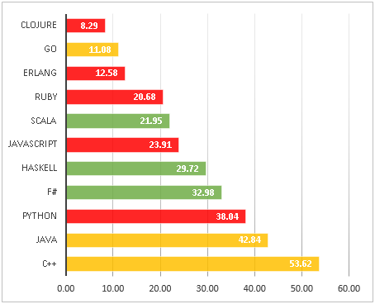
A discussion on language and bug counts
http://labs.ig.com/static-typing-promise

Slide 15
My Contact Details
Email: paul@marrington.net
Twitter: paulmarrington
GitHub: github.com/paulmarrington
Wordpress: https://paulmarrington.wordpress.com/
Lispz: http://lispz.net

